Slide 1
Thermal Imaging
YOUR SUBTEXT

Slide 2
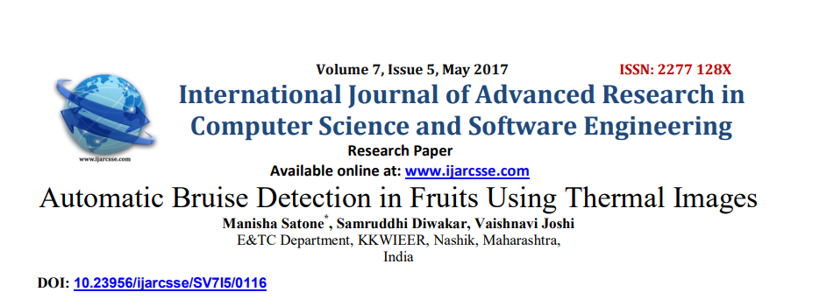
Paper 1
This paper tells the need and methods for detecting bruises on a fruit using thermal imaging
For India:
It is necessary as we heavily transport fruits and wastage happens because fruits rot by bacteria rooting them , that enters through this bruises
Fruit studied :
It was mainly apple, as It is available in all seasons and is easier to study on.
Studying method: Thermal Camera with simple passive thermography approach. Also we decided to use simple algorithm by using image processing techniques only and then to display results on LCD display connected to Arduino board. The software used for image processing will be directly interfaced with Arduino through a serial communication.
Automatic Bruise Detection in Fruits Using
THERMAL IMAGES

Slide 3
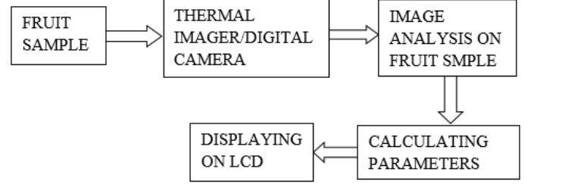
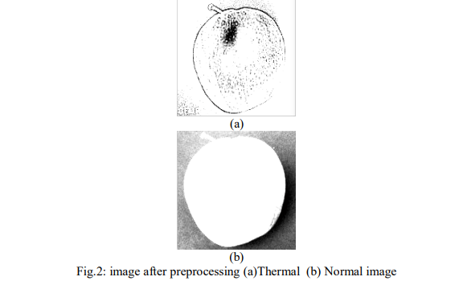
Hardware Requirement
1.Thermal imager: FLIR C2. The FLIR C2 is the world‟s first full-featured, pocket-sized thermal camera.
Arduino UNO Board.
3.LCD Display
Application Framework :
To develop image processing software MATLAB is used.
Preprocessing
Contrast Stretching: Contrast stretching attempts to improve an image by stretching the range of intensity values it contains to make full use of possible values.
Histogram Equalization: Histogram equalization is a technique for adjusting image intensities to enhance contrast. Histogram equalization is a method in image processing of contrast adjustment using the image's histogram.

Slide 4
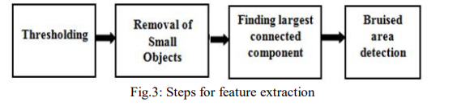
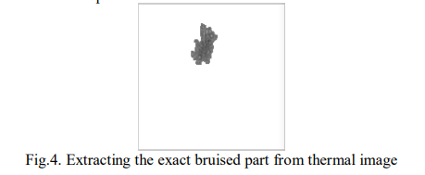
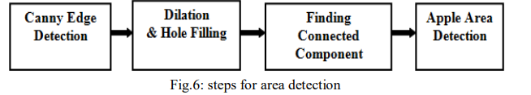
Median Filter: Smoothens the image and reduces noise by replacing a pixel's value with the median of the gray levels in its neighborhood.
Edge Detection: Utilizes Canny edge detection for accurate determination of object boundaries, outperforming other operators like Robert, Sobel, and Prewitt.
Dilation: Adds pixels to object boundaries, its extent determined by the size and shape of the structuring element. Essential for filling holes of defined shape and size within the object boundary.

Slide 5
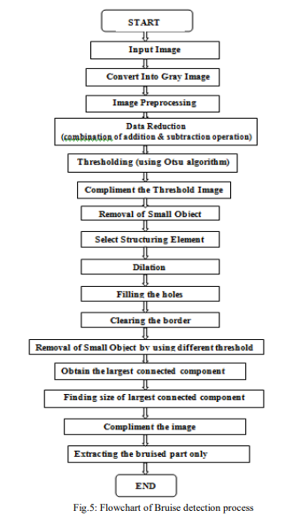
Median Filter: This filter replaces the value of a pixel with the median of the gray levels in its neighborhood, helping to smooth the image and reduce noise.
Edge Detection: Canny edge detection is employed to accurately determine object boundaries, which are crucial for defining the shape and position of the objects. Compared to other operators like Robert, Sobel, and Prewitt, Canny edge detection often yields superior results.
Dilation: Dilation operation adds pixels to the boundary of objects in an image, and the number of pixels added depends on the size and shape of the structuring element. This process is crucial for filling holes of a certain shape and size, as defined by the structuring element. A hole refers to a set of background pixels that cannot be reached by filling in the background from the edge of the image.

Slide 6
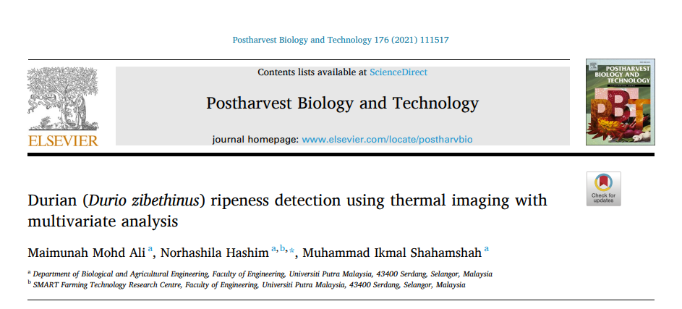
Paper 2
This paper tells about the detection of durian ripeness using thermal imaging is an essential study geared towards improving the current analytical methods which rely heavily on routine analysis and human labour skills.
Fruit studied :
Durians of the ‘Durian Kampung’ (888) variety were obtained from the Durian Nursery
Studying method: Thermal imaging was investigated in this study in order to evaluate the ripeness of durian based on the relationship of physicochemical properties and thermal image parameters.
Physicochemical properties involve : pH, firmness, moisture content etc.
Durian Ripeness Detection Using
Thermal image with multivariate analysis

Slide 7
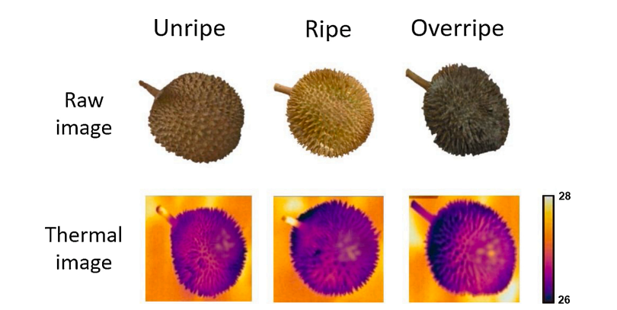
Hardware Requirement
An infrared thermal camera (FLIR E60, FLIR systems, King Hills, United Kingdom) ranging from 700 nm until 1400 nm, temperature ranging from − 20 ◦C to +650 ◦C equipped with a resolution 320 × 240 pixels and thermal sensitivity less than 0.05 ◦C was utilized to obtain thermal images
Application Framework :
To develop image processing software MATLAB is used.
Reference methods
Colour evaluation
Firmness
Soluble solids content
pH
Moisture content
Thermal image processing

Slide 8
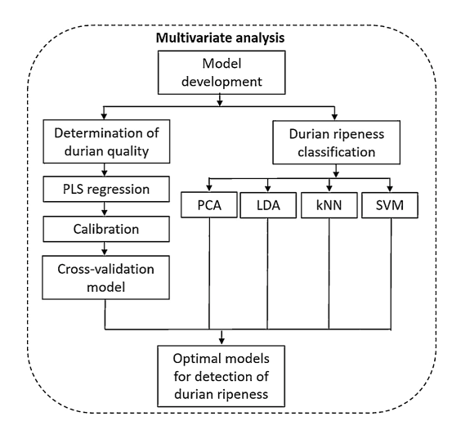
Multivariate data analysis :
Analysis of variance (ANOVA) was analysed to determine the significant differences between the durian samples and ripeness levels.
Principal component analysis (PCA) was employed to evaluate the classification representation between the ripeness levels of the durians.
Two principal components (PC), namely PC1 and PC2 were used from the greatest contribution of total variance in order to identify the classification of durian ripeness. PCA loading was used to select the optimum thermal parameters for the prediction of quality attributes in durians.
k-nearest neighbour (kNN), and support vector machine (SVM) algorithms are different multivariate tools that can be used to classify the ripeness of durian based on the thermal parameters

Slide 9
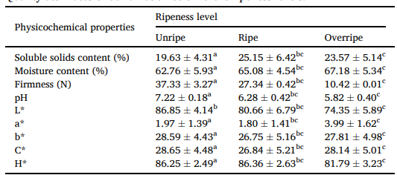
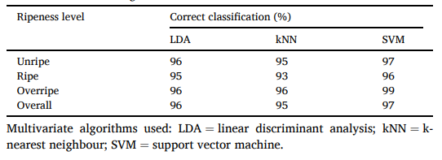
Results and Parameters:
The PLS models were used to monitor the prediction of the quality attributes of durian based on the optimum thermal parameter measurement.
Based on the findings, it can be noted that the SVM algorithm could classify the fruit into three commercial ripeness levels with high accuracy, which is simpler than high dimensional multiple regression analysis. Likewise, the SVM algorithm was found to be feasible for fruit classification according to the different ripening stages retrieved from the shape and texture features with the least error values for the classification accuracy.
The PLS models yielded good prediction of all physicochemical properties of durians with R2 > 0.94.

Slide 10
CallINg-NAME
-YOUR SUBTITLE HERE-
MORE DETAILS &
INFORMATION HERE
YOUR STATEMENT/STAT RIGHT HERE YOUR WORDS ARE OF IMPORTANCE
YOUR STATEMENT/STAT RIGHT HERE YOUR WORDS ARE OF IMPORTANCE
+1 582 466 7996 YOUR TELE IS IN THIS LOCATION
ADDRESS OR CITY HERE SECOND LINE OF INFO

Slide 11
MORE DETAILS &
INFORMATION HERE
This is where your subtext can go. This is for demonstration purposes to show you what the text would look like in this position.
Be sure when you tell your story your audience is engaged and ready to intake your message.s is where your second paragraph comes in, now it gets to the good stuff.
TITLE-NAME
< YOUR SUBTEXT GOES HERE >
LORUM IPSUM - EXAMPLE TEXT TO FILL IN THE AREA TO VIEW APPLICATION

Slide 12




YOUR TITLE & DESIGN
NAME- INSERT
+1 582 466 7996 YOUR TELE & LOCATION
Blocks of text & Your space YOUR INFORMATION HERE
Your Expertise and Education/Topic/Info Here YOUR INFORMATION HERE
www.yoururlgoeshere.com YOUR TELE & LOCATION

Slide 13
YOUR DESIGN
YOUR SUBTITLE

Slide 14
TRANSITION PAGE
MESSAGE HERE
<OPTIONAL SUBTEXT GOES HERE>

Slide 15

PICTURE CARD
<OPTIONAL SUBTEXT GOES HERE FOR A DESCRIPTION AND STATEMENT>

